Slide 1
Resolution Algorithm
Achilleas Tsakpinis
18.11.2022

Slide 2
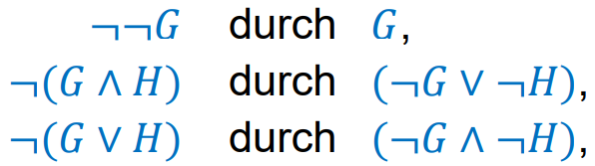
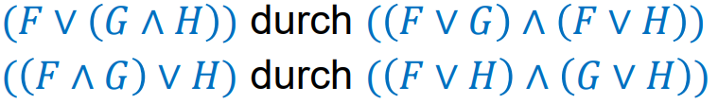






From form with $∨$ and $∧$ to CNF
1.
2.

Slide 3

Basics
Conjunctive Normal Form
  $\left\{a,b, ¬c\right\}==( a ∨b∨¬c)$
  $\left\{\right\}==false$
  $\left\{\{a,b\right\},\{c\}\}==(a ∨b) ∧c$

Slide 4
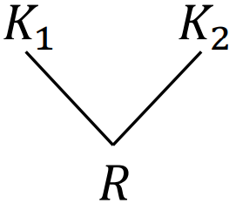
Algorithm
while 𝐹 does not contain { } {
  if 𝐹 contains two clauses 𝐾1, 𝐾2 with resolvent 𝑅,
  with 𝑅 ∉ 𝐹(= 𝑅 is not clause of 𝐹)
  then add 𝑅 as new clause to 𝐹;
  else return „ fulfillable”;
  }
return „not fulfillable“;

Slide 5
Example

Slide 6
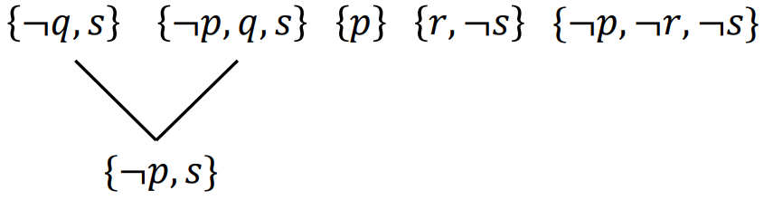
Example

Slide 7
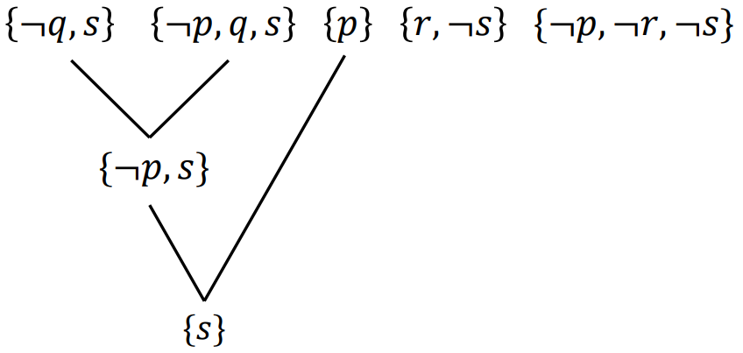
Example

Slide 8
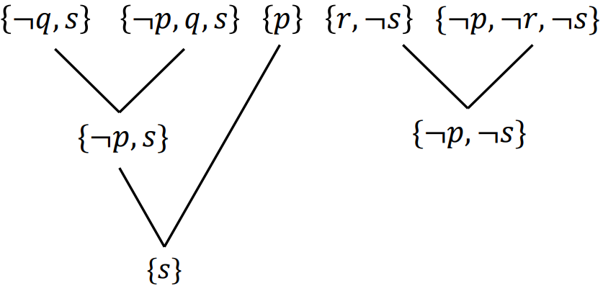
Example

Slide 9
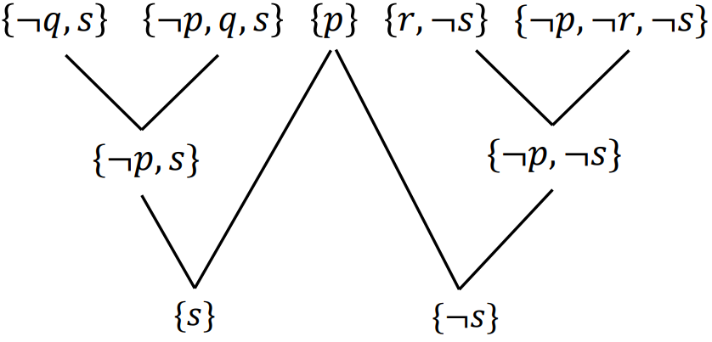
Example

Slide 10
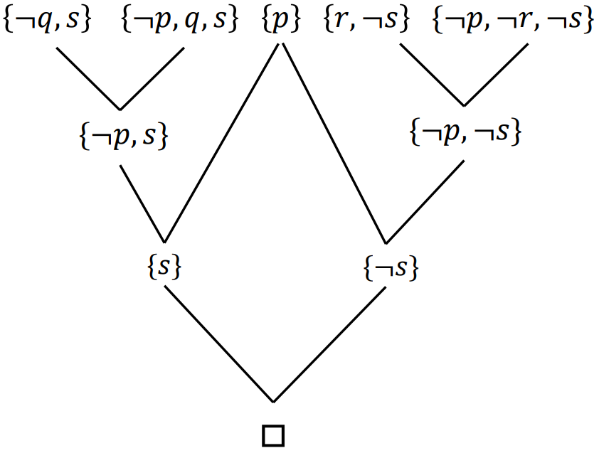
Example

Slide 11
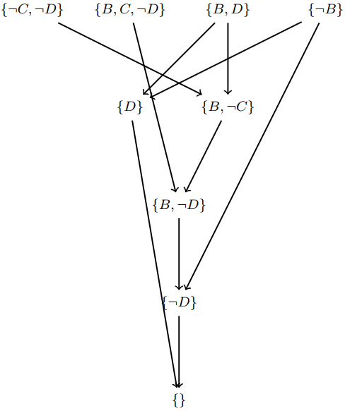
Example

Slide 12
Outcome
1. Terminates for every formular
2. If formular is fulfillable then the algorithm returns „fulfillable“
3. If formular is NOT fulfillable then the algorithm returns
„not fulfillable“

